Slide 1
COMP2003HK
Computing Group Project
Group 5

Slide 2
Project Planning Process
(Follow-up needed)
Articulation of the project planning process and design decisions.
Our audience is the client, so do not no need to take many time to talk about project background.
How our plan the whole project ?
Example: By what time / how much % we finish/How is the progress now ?

Slide 3
Design Decisions (Follow-up needed)
How you choose your gamification elements？
How you are paradise your functionalities？
Your choice for Platform / Program language?
Good to use Comparison or some choices that we come to our final.
Eg. We would like to use. Why was this decision made? It can't simply be because we only know XXX language.

Slide 4
Demonstration of an initial prototype

Slide 5
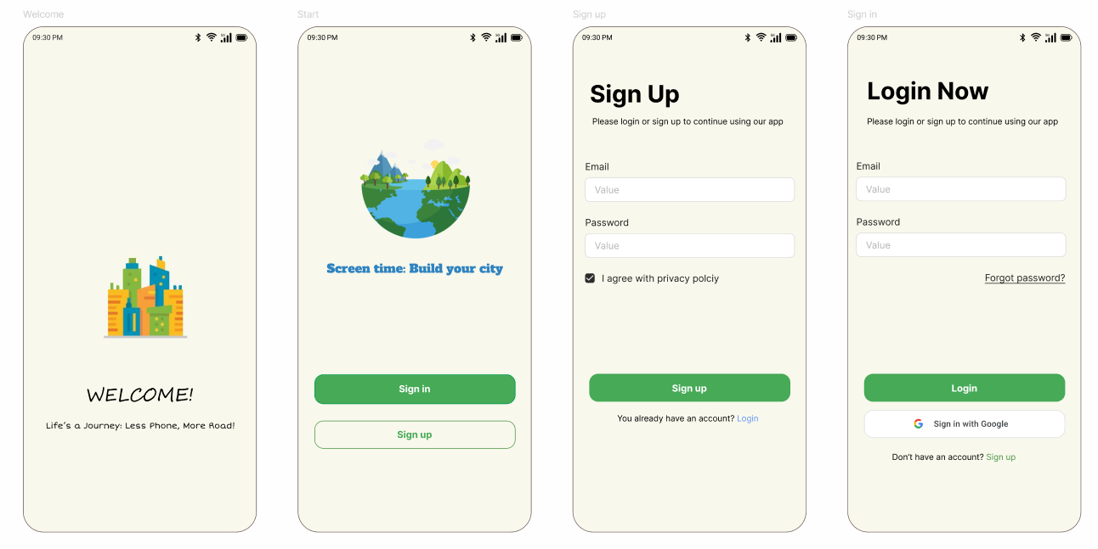
Welcome & User Login Page

Slide 6
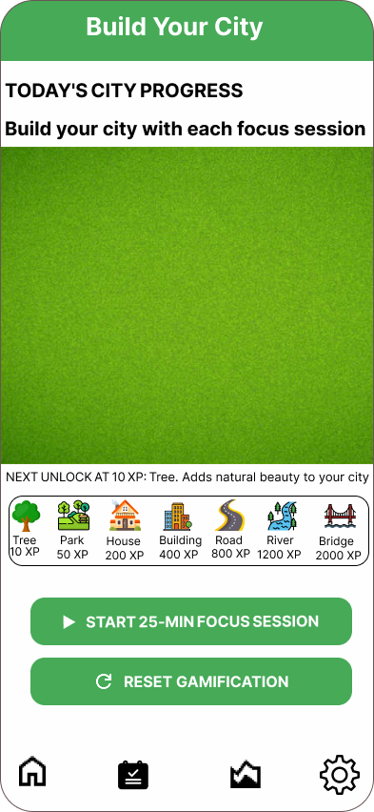
Home Page( Gamification )
Users earn XP by completing focus sessions
Spend XP to unlock building assets (trees, houses, roads)
Green spaces - drag & drop areas for personal utopia

Slide 7
Prioritized & Functionalities
MoSCoW method:
Must-have feature: Focus timers, city building, and activity logging form our core value
Should-have feature: Dashboards and notifications boost daily usage
Could-have features: like custom city themes remain optional for future iterations.
Won't-have features: such as leaderboards or social sharing were excluded to maintain privacy focus and scope control.

Slide 8
Technology Stack
Flutter: main development framework
Dart: programming language
SQLite: local database

Slide 9
Why This Combination Works
Single codebase for Android plus iOS
Smooth animations for city building
Secure offline data storage

Slide 10
Dashboard

Slide 11
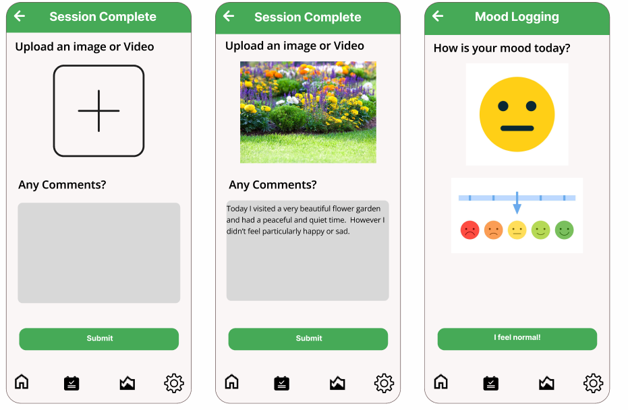
Session logging

Slide 12
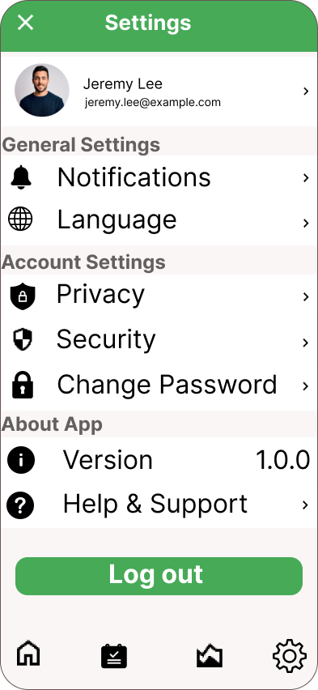
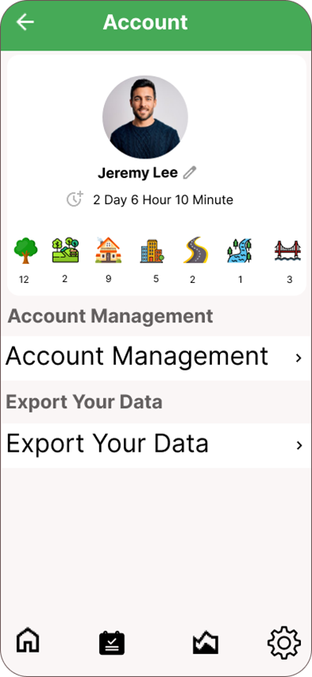
Setting Page

Slide 13
Q&A
Thank You

